Slide 1
Gestures Project
Myo-Powered Fruit Slicer Game

Slide 2
Myo Overview
Wearable technology
Uses mixture of accelerometer, magnetometer and gyroscope to detect arm motion.
Detects electrical signals from forearm muscles to recognise gestures.
5 standard gestures:
Close fist, spread fingers, wave left, wave right & double tap

Slide 3
Myo Review
Advantages:
Novel item.
Decent motion tracking
Not much else.
Disadvantages:
Uncomfortable for long usage periods
Constant need to re-sync device.
Unpredictable behaviour when battery is low

Slide 4
Project Architecture
FruitSpawner
FruitSlicer
CameraScript
Public Variables
Gesture Control
JointMovement
Motion Control
MYO SDK

Slide 5
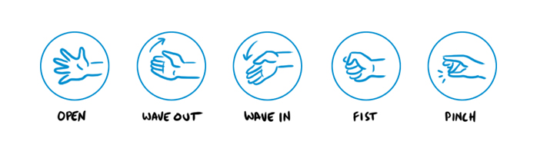
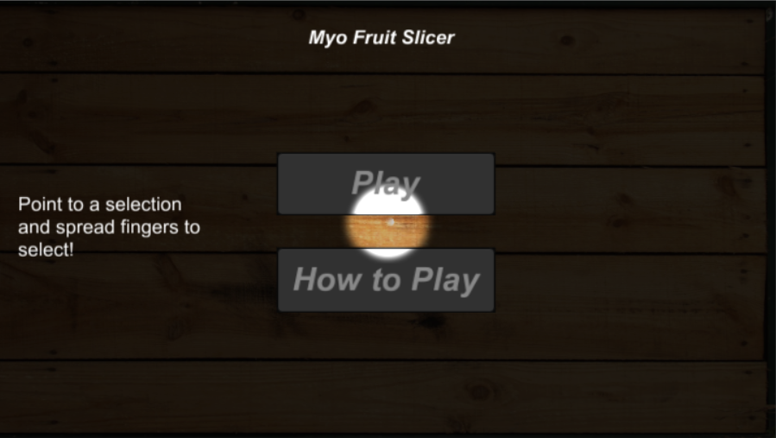
Gestures
Close Fist: Activate Powerup
Spread Fingers: Make selection
Pinch (Double tap): Re-center pointer

Slide 6
Difficulties Encountered
Syncing problems
Inconsistent gesture detection
Lag with gesture recognition
Constant warmup times
Armband may be unreliable when not calibrated properly for each user.

Slide 7
Conclusion
Interesting concept
Novel product at best
Not directed at mainstream audience
Due to constant need to re-sync and warmup, the Myo provides very limited applications

Slide 8
Demonstration

